Slide 1
The Fundamental of Mobile Robot
Machine Perception and Interaction Group (MPIG)
http://www.mpig.com.cn
szl@mpig.com.cn

Slide 2
Send an email with specified subject ‘Robot stuff’ to
assignments.shmtu@gmail.com
An automatic reply will come.
All you need would be included!

Slide 3

assignments.shmtu@gmail.com

Slide 4


All the codes accompanying this course are open-sourced at Github.
The project homepage:
https://github.com/sunzuolei/robotcourse
The git repository:
https://github.com/sunzuolei/robotcourse.git
Learn more about git:
http://en.wikipedia.org/wiki/Git_(software)
The best GUI-based git client on Windows:
https://code.google.com/p/tortoisegit/

Slide 5
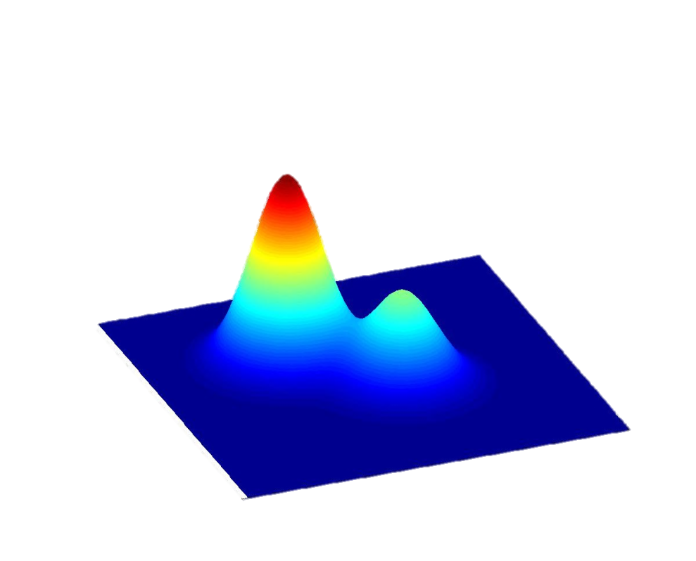
Particle filter
A Tutorial on Particle Filtering and Smoothing: Fifteen years later
http://www.cs.ubc.ca/~arnaud/doucet_johansen_tutorialPF.pdf

Slide 6
The particle filter was proposed for full nonlinear and non-Gaussian estimation, and has become a serious alternative for real-time applications classically approached by model-based Kalman filter techniques.
The more nonlinear the model is, or the more non-Gaussian the noise is, the more potential the PF has, especially in applications where computational power is rather cheap and the sampling rate is slow.
Generally, the basic theory of the general PF includes the sequential importance sampling (SIS) algorithm, the choice of importance density and resampling.

Slide 7

A General Convergence Result for Particle Filtering.pdf A Particle Filter for Bid Estimation in Ad Auctions with.pdf A Theoretical Framework for Sequential Importance Sampling with Resampling. Statistics for Engineering and Information Science. Springer.pdf A Tutorial on Bayesian Estimation and Tracking techniques applicable to nonlinear and non-gaussian processes.pdf A Tutorial on Particle Filtering and Smoothing fifteen years later.pdf A tutorial on particle filters for online nonlinearnon-Gaussian Bayesian tracking.pdf an overview of exsiting Methods and Recent Advances in SMC.pdf An Overview of Sequential Bayesian Filtering in Ocean Acoustics.pdf An overview of sequential Monte Carlo methods for parameter estimation in general state-space models.pdf An Overview on Bayesian Tracking for Video analytics.pdf Bayesian Filtering--From Kalman Filters to particle filter.pdf Bayesian Tracking for Video Analytics.pdf Improvement Strategies for Monte Carlo Particle Filters.pdf New probabilistic inference algorithms that harness the strengths of variational and monte carlo methods.pdf Nonlinear Filters Beyond the Kalman filter.pdf ONLINE SEQUENTIAL MONTE CARLO EM ALGORITHM.pdf Particle Filter Theory and Practice with positioning applications.pdf particle filtering---IEEE signal process. Magazine.pdf Particle Filters for Positioning, Navigation and tracking.pdf Particle Filters in Robotics.pdf Particle_Filters_in_Decision_Making_Problems_under_Uncertainty.pdf Recent Developments in Auxiliary Particle Filtering.pdf PF in geophysical systems.pdf Sequential Decision Making in General state space models.pdf Sequential Monte Carlo Methods a Survey.pdf stochastic_filtering_ a brief tutorial.pdf Unscented Filtering and Nonlinear Estimation.pdf Particle Distribution Optimization (PDO): A Fundamental Requirement of Particle Filters.pdf
http://bbs.sciencenet.cn/thread-558717-1-1.html

Slide 8
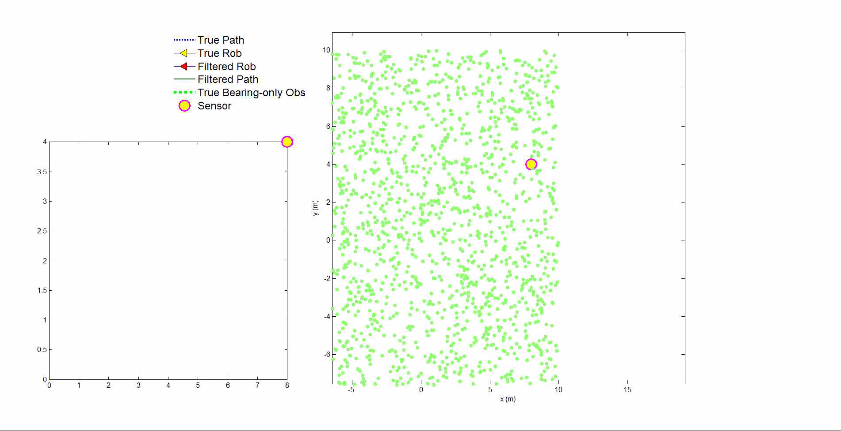
P61

Slide 9
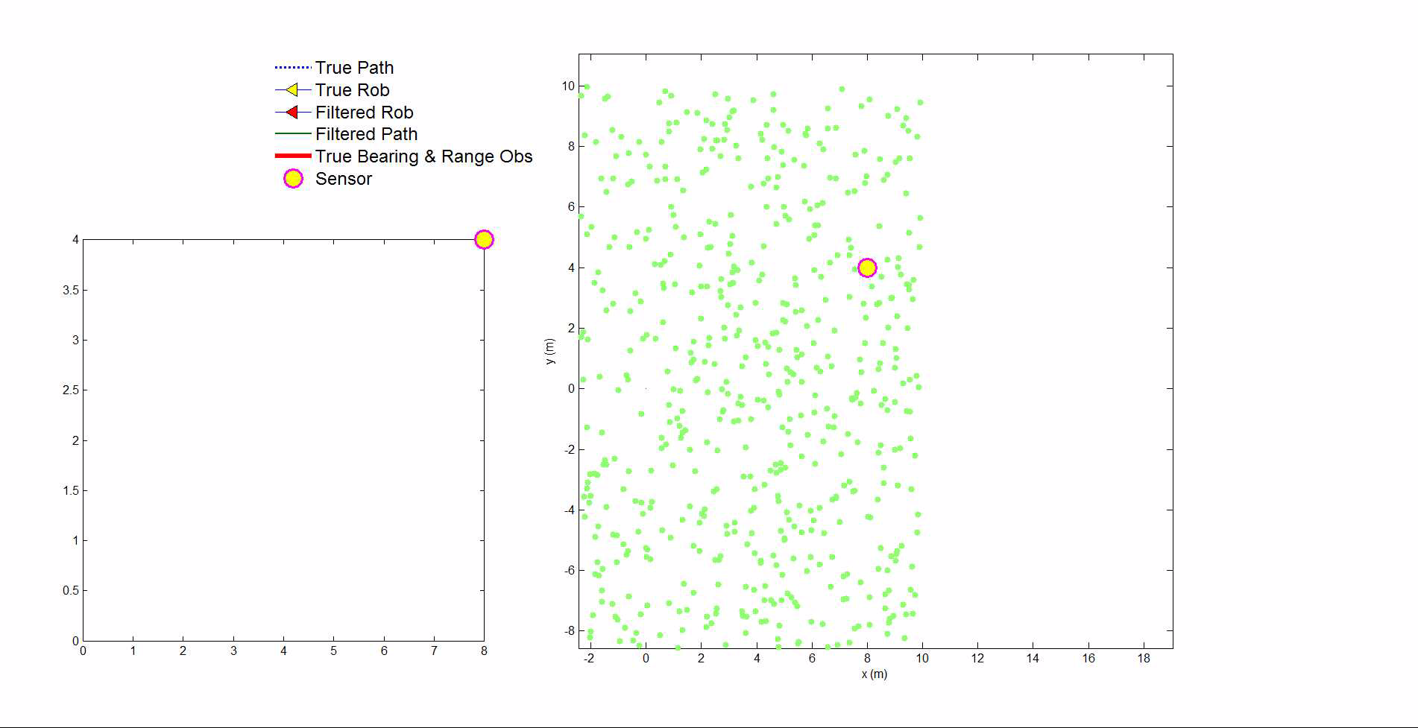
P64

Slide 10
P61
P64
Bearing-only
2000 particles
Bearing & Range
1000 particles

Slide 11
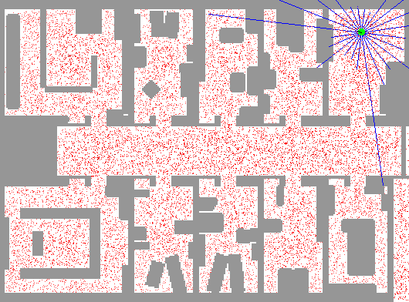

Slide 12
Parametric filtering the fixed functional form of posterior
Unimodal
Approximates the nonlinear transformation
Multi-hypothesis Kalman filter
Mean
Covariance
EKF

Slide 13
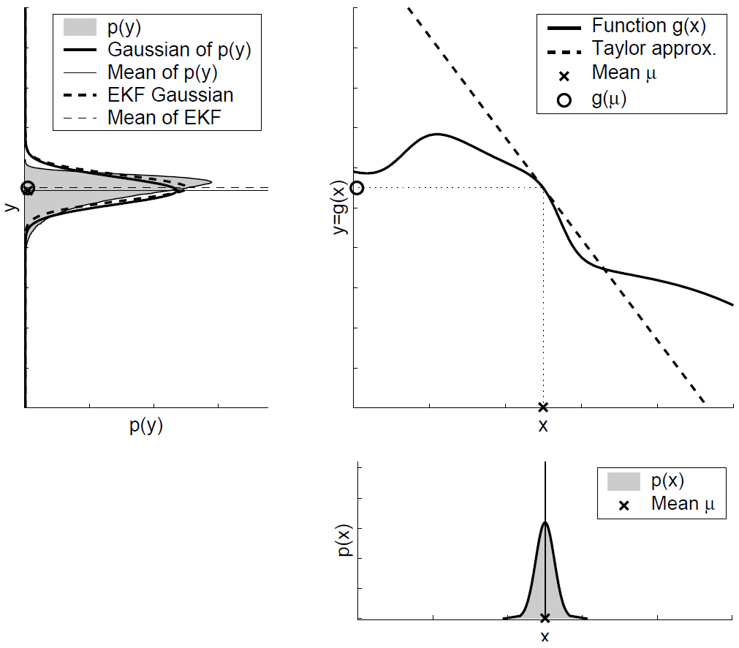
EKF

Slide 14
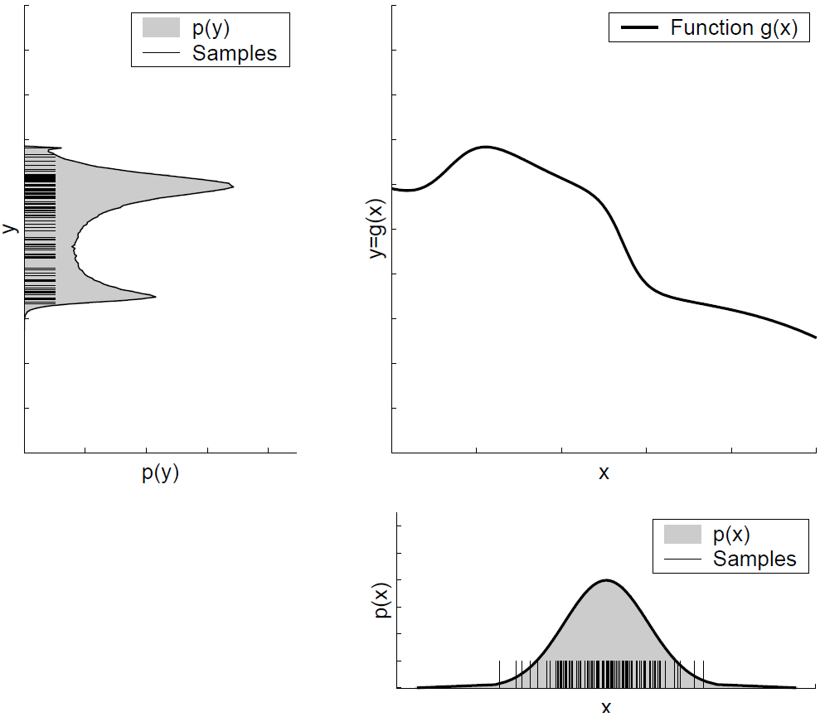
PF

Slide 15
From EKF to PF

Slide 16
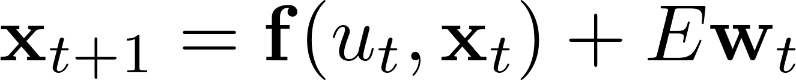
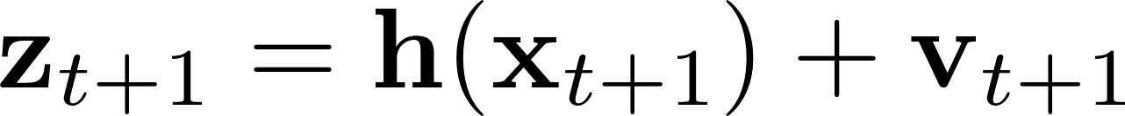
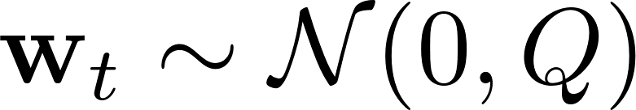
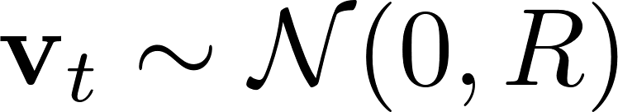
General Nonlinear models
Nonlinear motion model
Nonlinear sensor model

Slide 17
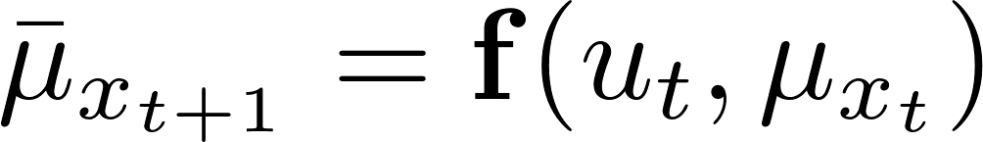
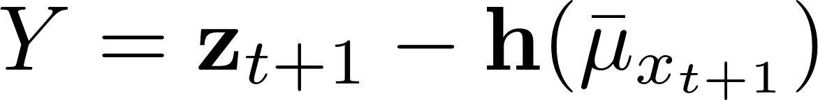
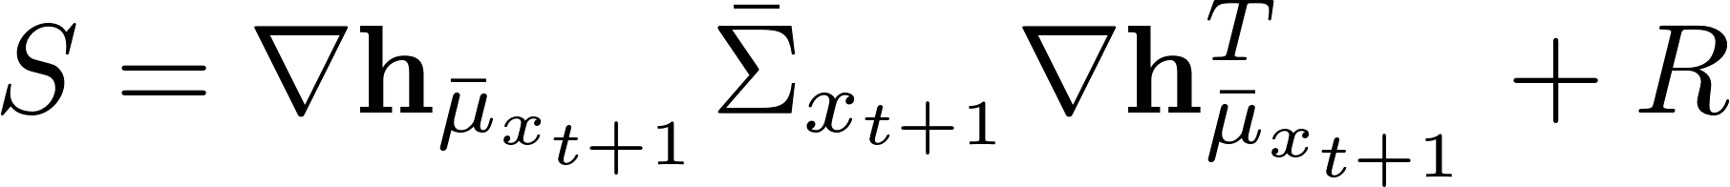
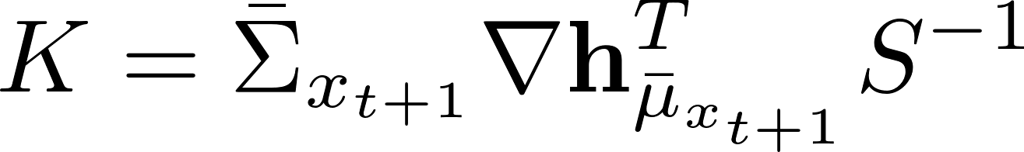
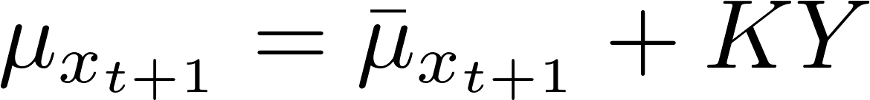
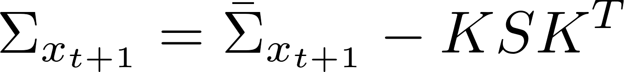
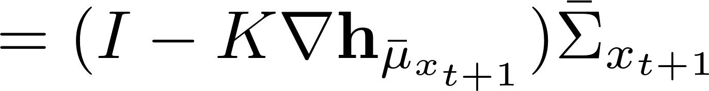
Prediction
Update
Innovation / Residual
Innovation variance
Kalman gain
Extended
Kalman filter

Slide 18
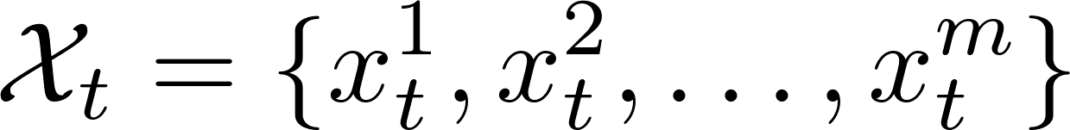
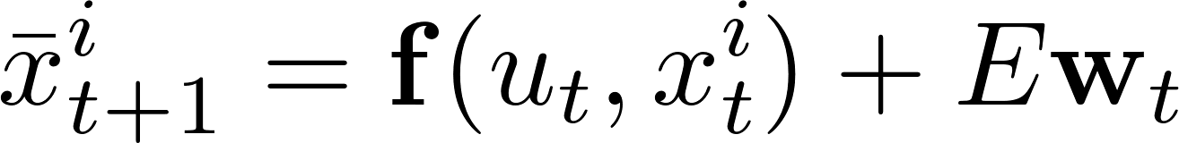
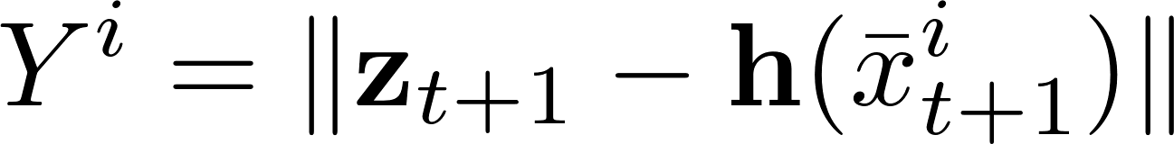
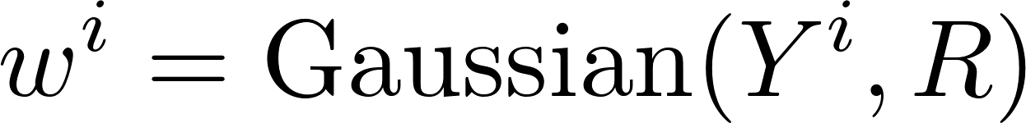
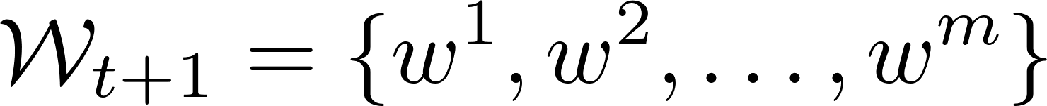
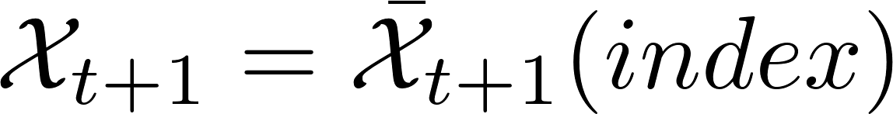
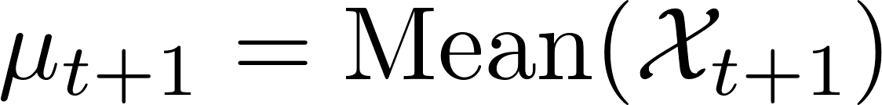
Prediction
for i = 1 : m
end
Update
for i = 1 : m
PF
end
Particle filter

Slide 19
Initialization
Prediction
Weight
Resampling

Slide 21
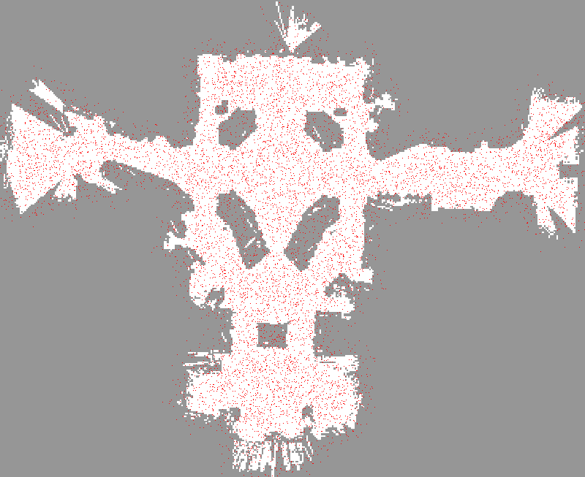

Slide 22
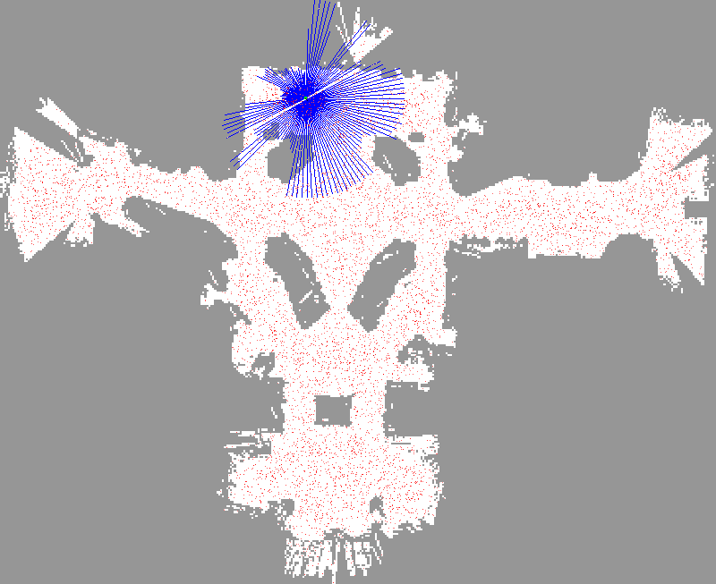

Slide 23
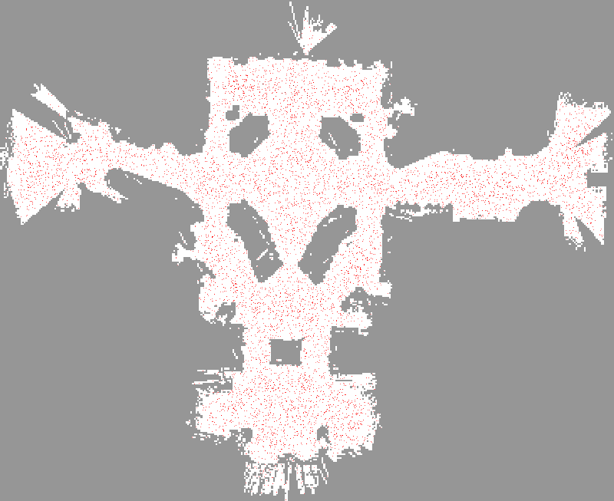

Slide 24
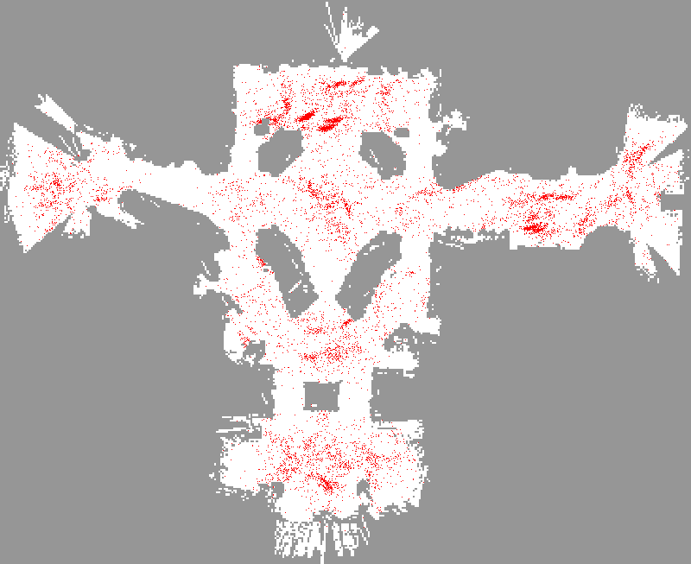

Slide 25
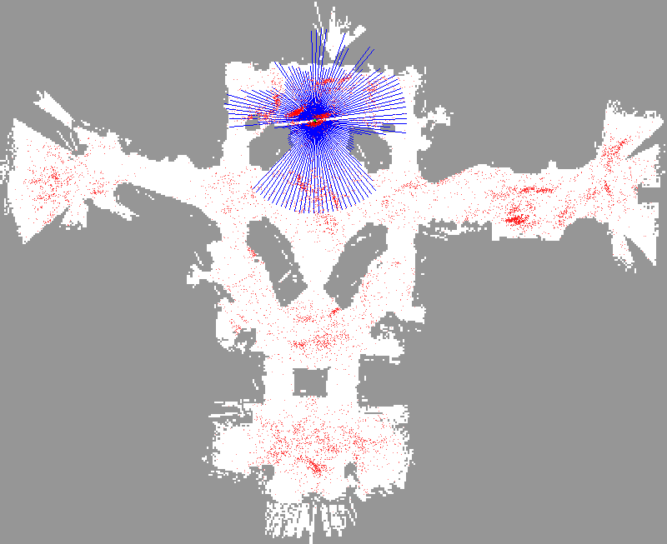

Slide 26
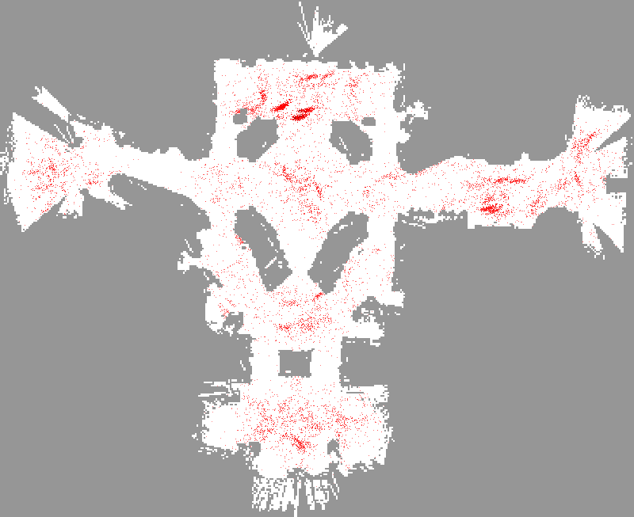

Slide 27
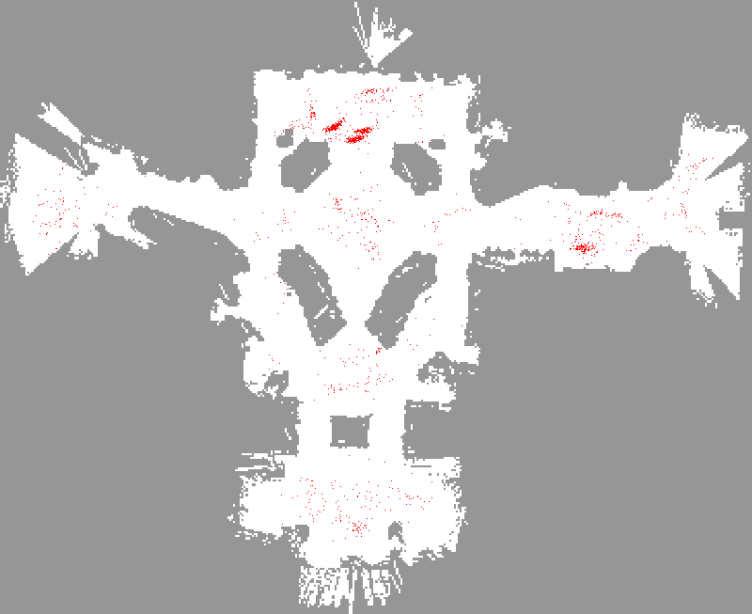

Slide 28
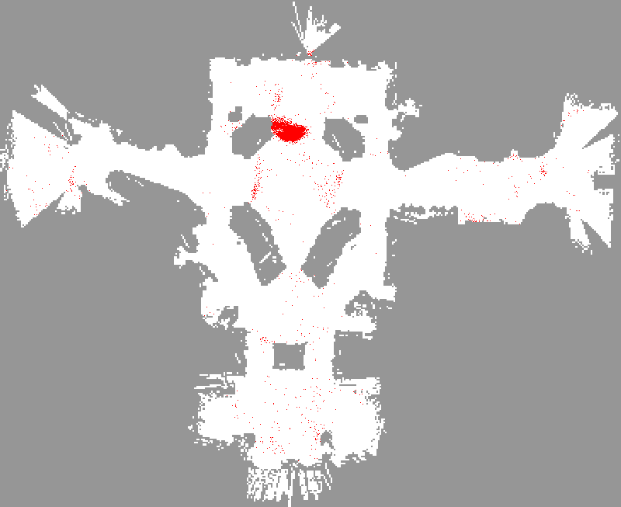

Slide 29
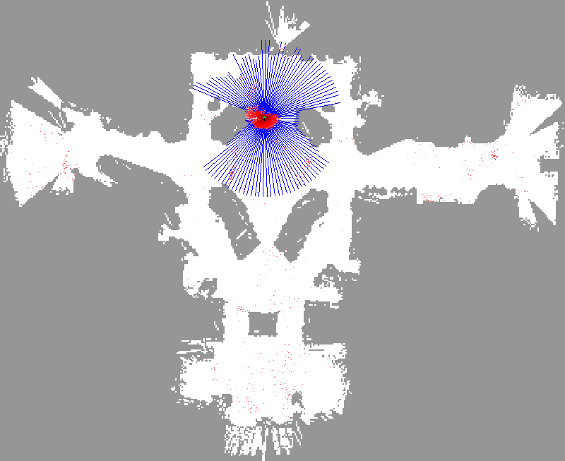

Slide 30


Slide 31
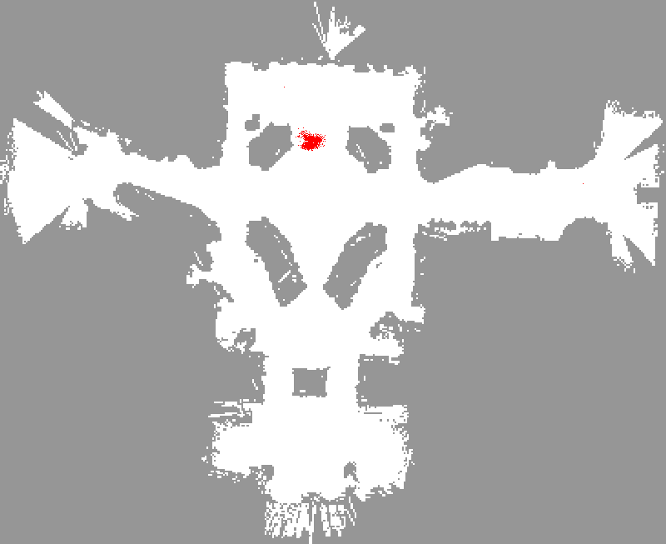

Slide 32
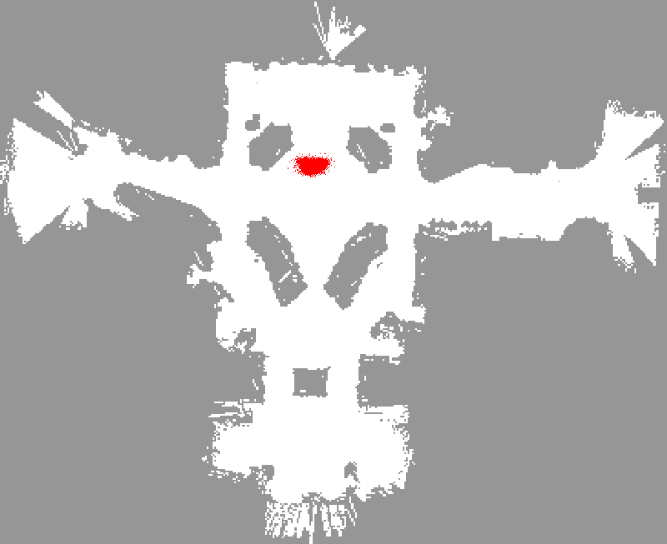

Slide 33
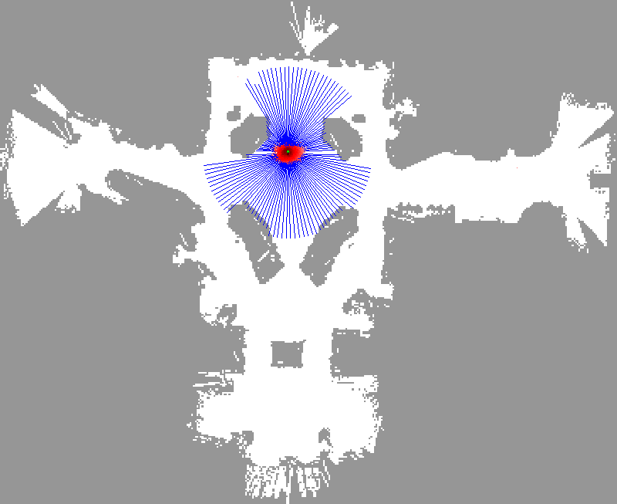

Slide 34
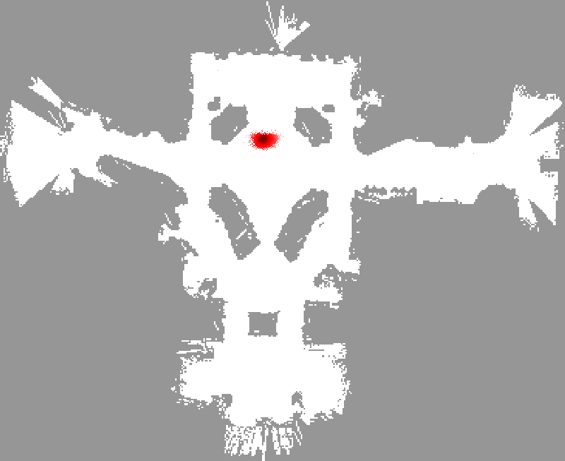

Slide 35
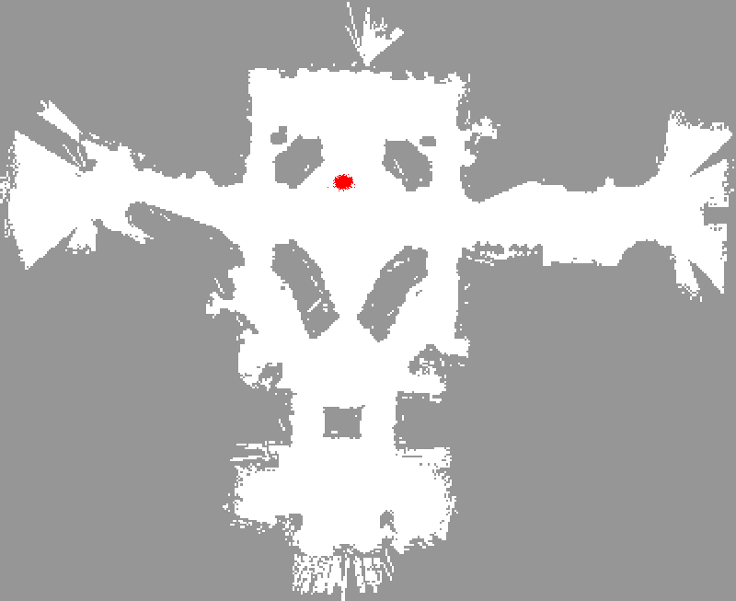

Slide 36
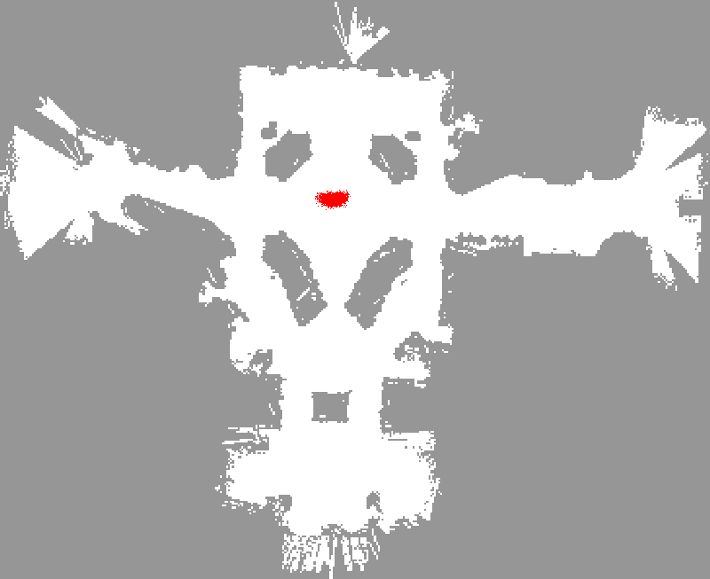

Slide 37
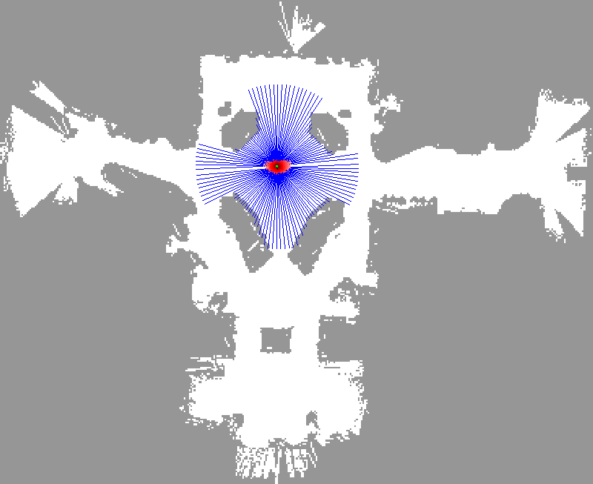

Slide 38
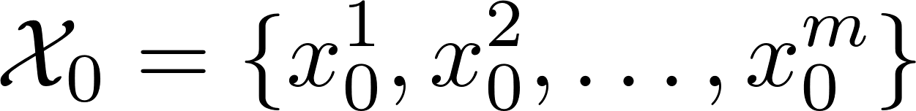
Generate arbitrary random number
PF initialization

Slide 39
Prediction
for i = 1 : m
end
Update
for i = 1 : m
PF
end
Particle filter

Slide 40
function r = arbitraryRand(nRow, nCol, minR, maxR)
if minR > maxR
error('minR should be smaller than maxR!');
end
r = rand(nRow, nCol) * (maxR - minR) + minR;
end
m = 1000;
xLim = [-100, 100];
yLim = [30, 190];
p = [arbitraryRand(1, m, xLim(1), xLim(2));...
arbitraryRand(1, m, yLim(1), yLim(2))];
w = rand(1, m);
%%
figure(1)
scatter(p(1,:), p(2,:), 31, w, 'fill');
axis([-130, 130, 0, 220]);
axis equal;
P59

Slide 41
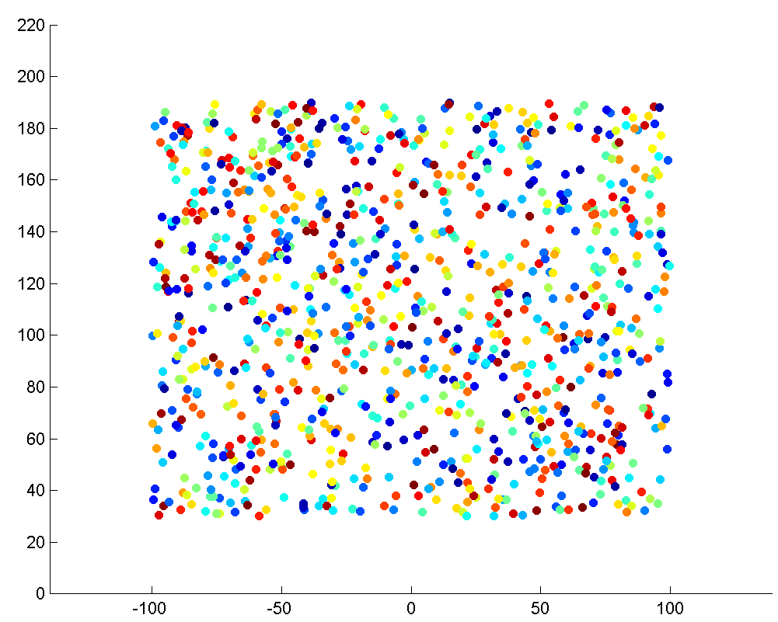

Slide 42
Compute weights

Slide 43
Prediction
for i = 1 : m
end
Update
for i = 1 : m
PF
end
Particle filter

Slide 44
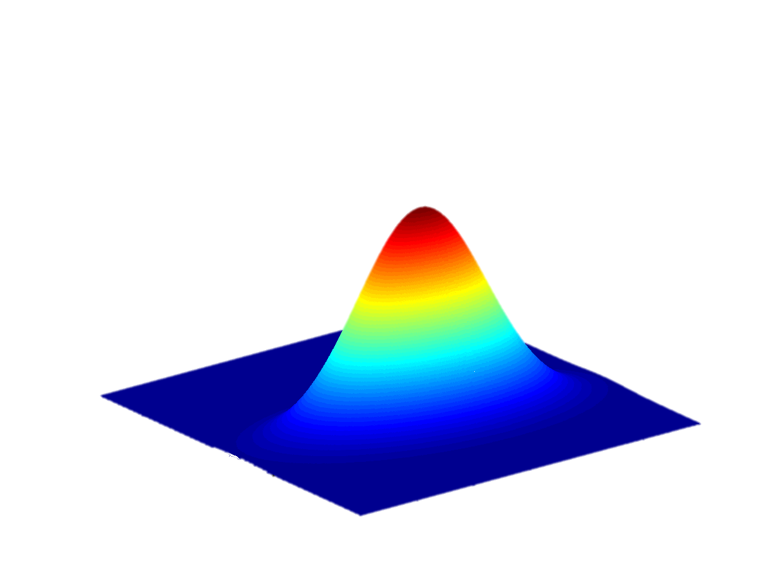
function w = compWeight(zPred, zTrue, Sigma, hasAngle, idxAngle)

Slide 45
General solution to 0=2pi problem
Always bound the resulting angles using function piTopi.

Slide 46
function w = compWeight(zPred, zTrue, Sigma, hasAngle, idxAngle)
Y = abs(zPred - zTrue);
if hasAngle
Y(idxAngle) = piTopi( Y(idxAngle) );
end
w = det(2 * pi * Sigma)^(-0.5) * exp(-0.5 * Y'/Sigma * Y) + 1e-99;
Sigma = 0.1;
zTrue = degtorad(179);
zPredA = degtorad(178); % error: 1
zPredB = degtorad(-179); % error: 2
zPredC = degtorad(-178); % error: 3
zPredD = degtorad(185); % error: 6
zPredE = degtorad(0); % error: 179
%% The bigger the error, the smaller the weight.
wA = compWeight(zPredA, zTrue, Sigma, true)
P60

Slide 47
wA = 1.2596
wB = 1.2539
wC = 1.2444
wD = 1.1943
wE = 8.0687e-22
Sigma = 0.1;
zTrue = degtorad(179);
zPredA = degtorad(178); % error: 1
zPredB = degtorad(-179); % error: 2
zPredC = degtorad(-178); % error: 3
zPredD = degtorad(185); % error: 6
zPredE = degtorad(0); % error: 179
%% The bigger the error, the smaller the weight.
wA = compWeight(zPredA, zTrue, Sigma, true)
P60

Slide 48
Resampling

Slide 49
Prediction
for i = 1 : m
end
Update
for i = 1 : m
PF
end
Particle filter

Slide 50
The most difficult component in PF
A huge number of literatures focus on the topic of sequence importance resampling.
Four flavor are implemented in function resampleParticle
http://www.stat.columbia.edu/~liam/teaching/neurostat-spr12/papers/EM/resampling.pdf
http://www.dynare.org/dynare-matlab-m2html/matlab/particle/resample.html

Slide 51

newInd = resampleParticle(weight, 'hugh');

Slide 52
newInd = resampleParticle(weight, 'hugh');

Slide 53
n = 500;
m = 5;
particle = zeros(2, n);
% weight = randn(1,n).^2;
weight = exp(randn(1,n));
%%
figure('name', 'Test resampling', 'units','normalized',...
'outerposition',[0 0 1 1]);
subplot(m, 1, 1)
stem(weight, 'markersize', 3, 'MarkerFaceColor','red','MarkerEdgeColor','red');
ylabel('Weight');
xlim([1, n]);
P62

Slide 54
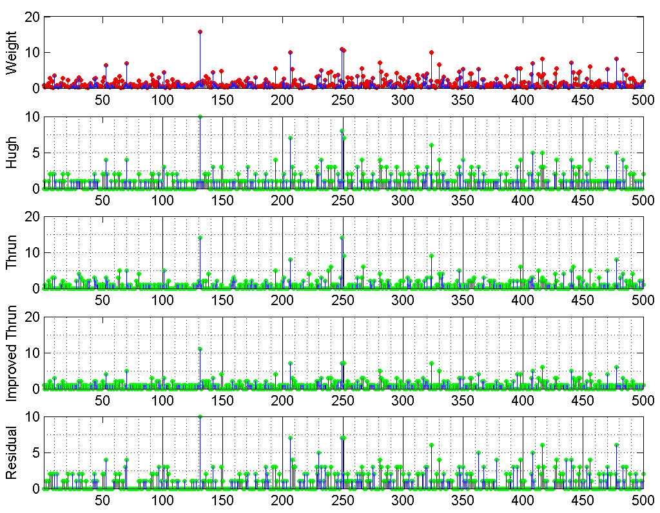

Slide 55
Mean angles
http://rosettacode.org/wiki/Averages/Mean_angle

Slide 56
Prediction
for i = 1 : m
end
Update
for i = 1 : m
PF
end
Particle filter

Slide 57
When calculating the average or mean of an angle one has to take into account how angles wrap around so that any angle in degrees plus any integer multiple of 360 degrees is a measure of the same angle.
If one wanted an average direction of the wind over two readings where the first reading was of 350 degrees and the second was of 10 degrees then the average of the numbers is 180 degrees,
whereas if you can note that 350 degrees is equivalent to -10 degrees and so you have two readings at 10 degrees either side of zero degrees leading to a more fitting mean angle of zero degrees.

Slide 58
Assume all angles are on the unit circle and convert them to complex numbers expressed in real and imaginary form.
Compute the mean of the complex numbers.
Convert the complex mean to polar coordinates whereupon the phase of the complex mean is the required angular mean.

Slide 59
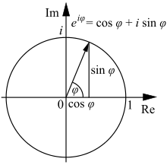
function outAng = meanAngle(inAng, dim, sens)
in = exp( inAng * 1i ); % According to Euler's formula
mid = mean( in, dim );
outAng = atan2( imag(mid), real(mid) );
outAng( abs(mid) < sens ) = nan;
P63
http://en.wikipedia.org/wiki/Euler%27s_formula

Slide 60
angs = degtorad([-177, 179]);
disp(radtodeg(meanAngle(angs)));
angs = degtorad([350, 10]);
disp(radtodeg(meanAngle(angs)));
angs = degtorad([10, 20, 30]);
disp(radtodeg(meanAngle(angs)));
angs = degtorad([90, 180, 270, 360]);
disp(radtodeg(meanAngle(angs)));
P63
-179
-1.6148e-15
20.0000
-90

Slide 61
Implement PF with bearing-only sensor

Slide 62
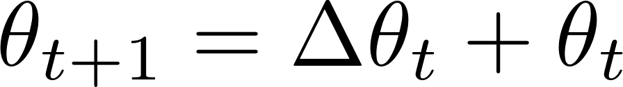
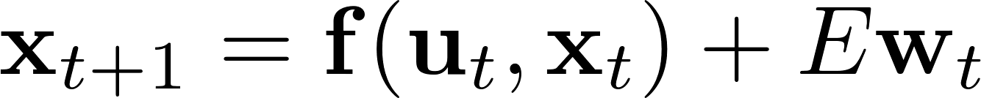
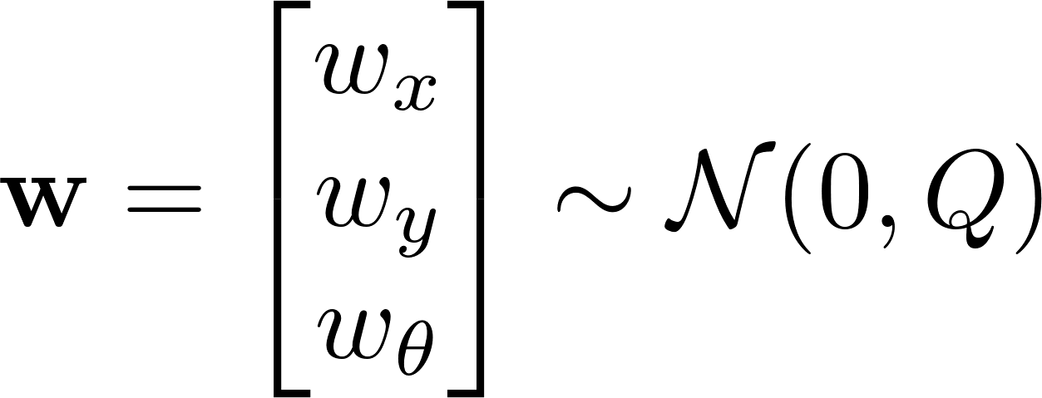
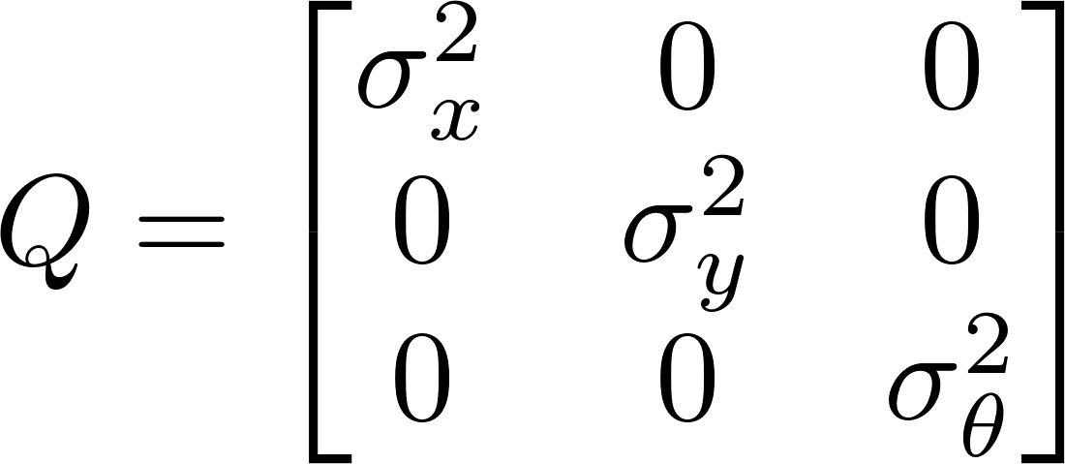
Motion model
nonlinear

Slide 63

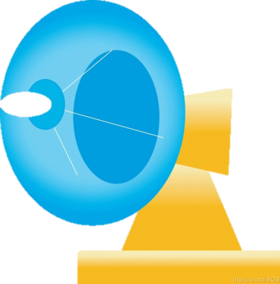


Measurement
model
nonlinear

Slide 64
Just play with the codes!
Tune the arguments and see the results.
Note that the performance is quite sensitive to the number of particles and the process noise.
Generally, the process noise should be larger than the motion noise employed in generating the ground truth to ensure the sampled particle set more probably covers the true state.
P61

Slide 65
PF Demo with Bearing & range

Slide 66
Motion model
nonlinear

Slide 67

Measurement
model
nonlinear

Slide 68
P61
P64
Bearing-only
2000 particles
Bearing & Range
1000 particles

Slide 69
Particle filters are an implementation of recursive Bayesian filtering
They represent the posterior by a set of weighted samples.
In the context of localization, the particles are propagated according to the motion model.
They are then weighted according to the likelihood of the observations.
In a re-sampling step, new particles are drawn with a probability proportional to the likelihood of the observation.

Slide 70
The particle filter is the easiest to implement, but the complexity scales exponentially with the number of dimensions.
It is more expensive that KF-liked data fusion algorithm.

Slide 71
Cool PF demos
They are produced by Sebastian Thrun @ Stanford

Slide 72


The robotic tour guide at National Museum of American History

Slide 73

Vision-based Localization
P(z|x)
z
h(x)

Slide 74


Under a Light
Measurement z:
P(z|x):

Slide 75


Next to a Light
Measurement z:
P(z|x):

Slide 76


Elsewhere
Measurement z:
P(z|x):

Slide 77


Slide 78


Slide 79

PF Demo with sonar
http://veterobot.com/
An open sourced and 3D printed robot

Slide 80
Sophisticated PF…

